Slide 1
Predictive Modeling for Loan Approval Rates
Submitted in the partial fulfillment for the award of the degree of
BACHELOR OF ENGINEERING
IN
AI-ML
Submitted by:
Under the Supervision of:
Prof. Pramod Vishwakarma
KARAN JAIN | 21BCS8804
VATHADA LIKHITH SAI | 20BCS4593
MITALI GUPTA | 20BCS6890
HITESH GARG | 20BCS6614
Department of AIT-CSE
DISCOVER . LEARN . EMPOWER

Slide 2
Outline
Introduction to Project
Problem Formulation
Objectives of the work
Methodology used
Results and Outputs
Conclusion
Future Scope
References

Slide 3
INTRODUCTION
Technology has boosted the existence of human kind the quality of life they live. Every day we are planning to create something new and different.
We have a solution for every other problem we have machines to support our lives and make us somewhat complete in the banking sector candidate gets proofs/ backup before approval of the loan amount.
The application approved or not approved depends upon the historical data of the candidate by the system.

Slide 4
Every day lots of people applying for the loan in the banking sector but Bank would have limited funds. In this case, the right prediction would be very beneficial using some classes-function algorithm.
Example : logistic regression, random forest classifier, support vector machine classifier, etc.
Therefore it is important to apply various techniques in banking sector for selecting a customer who pays loan on time

Slide 5
Problem Formulation
The main purpose of this project is to provide immediate and accurate results for the approval of loan to the eligible customers. In banking sector there will be n number of people who apply loans.
It is difficult to check customer’s eligibility through paper work. The system can provide accurate results for the n number of people. In this project we have discussed about credit risk and credit analysis.
Ensemble method compares two or more models and identifies a perfect model from two or more models for better loan prediction which makes banking sector to make a right choice for approval of loan application.

Slide 6
OBJECTIVES
The main objective of banks is to invest their assets in safe customers. Up to now many banks are processing loans after regress process of verification and validation. But till now no bank can give surety that the customer who is chosen for loan application is safe or not.
So to avoid this situation we introduced a system for the approval of bank loans known as Loan Prediction System Using Python.
Loan Prediction System is a software which checks the eligibility of a particular customer who is capable of paying loan or not.
This system checks various parameters such as customer’s martial status, income, expenditure and various factors. This process is applied for many customers of trained data set.

Slide 7
Methodology
When we submit our training dataset to these classifiers produce output according to their algorithm function.
This method is known as Heterogenous classifying or Ensemble learning. We can also take all learner classifier as same algorithm. But when we upload same training dataset these all classifiers produce same output.
To avoid this problem we have given different training dataset to these classifiers, So that each classifier gives different outputs. While providing the output these classifiers considering various factors build a model.

Slide 8
Each classifier may build a model according to given training dataset. From these different classifiers we combine all these classifiers a build a new classifier model which satisfies all these classifiers.
This classifier is considered as Strong Classifier. This is called Strong classifier because it produces accurate output and less error. Random Forest also uses this Ensemble Learning Technique

Slide 9
RESULTS
Loan Approval System software used for approval of loan in banking sector. In this system we have used machine learning algorithm.
Machine Learning is process in which a symmetric model is build from the existing dataset; this model is applied for the testing of the new dataset. The system consists of trained dataset and test dataset.
The trained dataset is used for construction of model. This model is applied on testing dataset for the required result. We have used Ensemble approach for building of the model. Random forest algorithm uses this ensemble approach and builds a model from the existing training dataset.

Slide 10
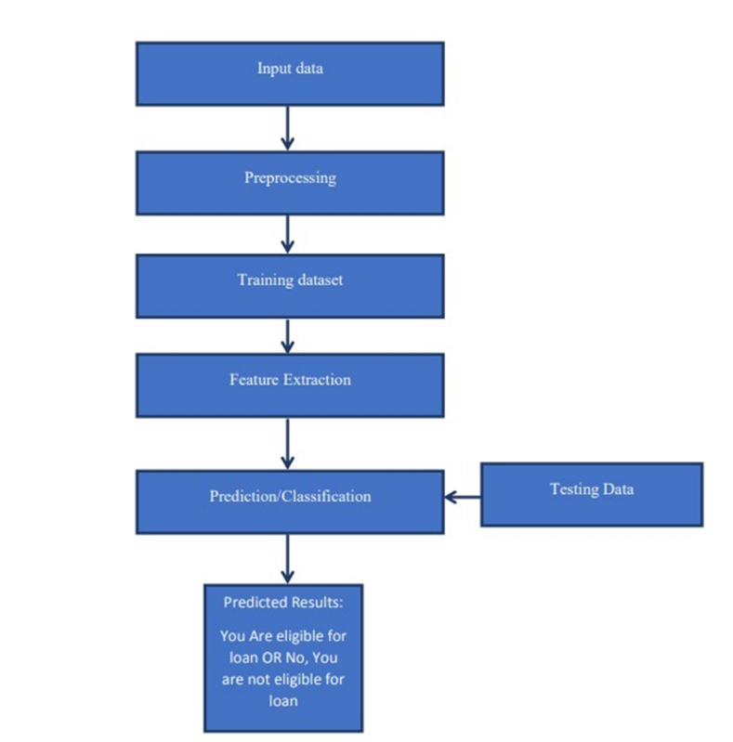
FLOWCHART

Slide 11
CONCLUSION
In conclusion, our research on amalgamation concept generation using image diffusion has provided a novel and innovative approach towards creating composite images from multiple input images.
Our proposed method leverages the use of image diffusion techniques to seamlessly blend and merge the input images, resulting in a fresh and unique concept.
Our findings highlight the importance and significance of image diffusion in amalgamation concept generation and its potential to contribute towards advancing the field of computer vision and image processing

Slide 12
FUTURE SCOPE
Real-time Decision Making: As computational capabilities improve, there's potential for real-time loan decision-making systems. This could enable financial institutions to process loan applications instantly, providing a seamless experience for customers.
Automation and Efficiency: Automation of the loan approval process can lead to significant cost savings and operational efficiencies for financial institutions. Machine learning can streamline various aspects of the lending process, from application processing to risk assessment and portfolio management.
Personalization: Tailoring loan products to individual borrowers' needs and risk profiles can be facilitated through machine learning. This might involve dynamic pricing strategies or personalized recommendations based on a borrower's financial behavior and credit history.

Slide 13
References
[1] K. Hanumantha Rao., G. Srinivas., A. Damodhar., M.Vikas Krishna., Implementation of Anomaly Detection Technique Using Machine Learning Algorithms: International Journal of Computer Science and Telecommunications, Vol. 2, Issue 3, 2011.
[2] S.S. Keerthi., E.G. Gilbert., Convergence of a generalize SMO algorithm for SVM classifier design, Machine Learning, Springer, Vol. 4, Issue 1, pp. 351-360,
2002.

Slide 14
[3] Andy Liaw., Matthew Wiener., Classification and Regression by random Forest, Vol. 2, Issue 3, pp. 9-22, 2002.
[4] Ekta Gandotra., Divya Bansal., Sanjeev Sofat., Malware Analysis and Classification: A Survey, Journal of Information Security, Vol. 05, Issue 02, pp. 56-64,

Slide 15
[5] Rattle data mining tool, http://rattle.togaware.com/rattle
-download.html.
[6] Aafer Y., Du W., Yin H., Droid APIMiner: Mining
API-Level Features for Robust Malware Detection in
Android, Security and privacy in Communication
Networks, Springer, pp 86-103, 2013.

Slide 16
THANK YOU !!

